Slide 1
Username
Ethan
Login
****
Login Help
Go!
Teacher Shortcut
Notes:
How Computers Work – Login screen

Slide 2
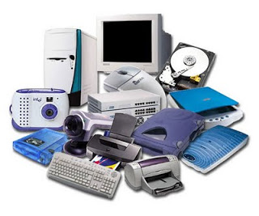
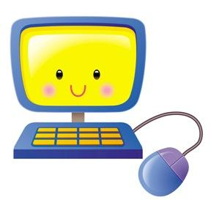
Welcome Back Ethan!
Welcome Back Ethan!
Your Progress
Types of Computers
Computer Parts
Function of Parts
Computer Scientists
Options
Free Play
Help
Notes:
This is the home screen after a student logs in. The Help button will show the tutorial of how to navigate. Examples include, pressing the red button to logout (only on the home screen to ensure proper exit), icons control what units student explores next.

Slide 3
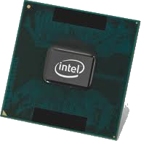
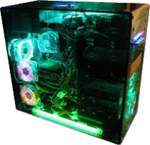
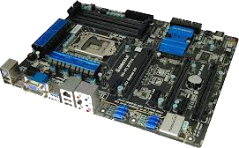
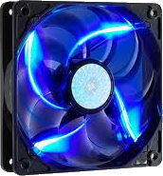
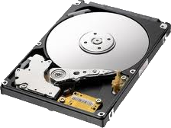
Computer Parts
Click the icons below to learn about each computer part:
Your Progress
Mouse
Options
Help
Notes:
This is the computer parts screen. The scroll bar on the right allows the student to see more parts. Parts that have been assigned are highlighted in pink. Parts that can not be clicked on are grayed out.

Slide 4
Computer Parts
Learn about the mouse
Activity 1: Images of the mouse
Activity 2: Find the Parts
Activity 2: Function Sort
Your Progress
Options
Help
Notes:
The Computer Parts Activity screen gives the student activity options. Students can only click on the activity highlighted in yellow.

Slide 5
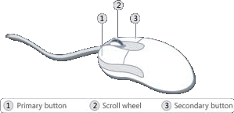
What is a mouse?
Your Progress
Options
A mouse is something you push along your desktop to make a cursor (pointing device) move on your screen.
Page 1 2 3 4 5 ...
Help
Notes:
When an activity is selected, the icon of that part will appear in the lower left hand corner of each page. The learner should click this icon if he/she wants to return to the list of computer parts. The home icon (how computers work icon) in the lower left hand corner takes the learner back to the home page. The progress bottom of the top indicates how many pages and the learner’s progress through all of the pages for the current computer part. Text will be presented with speech for individuals who have been assigned text to speech. Text can be clicked again to hear the sentence again. The magnifier can be clicked to enlarge the picture.

Slide 6
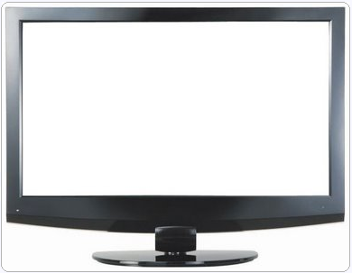
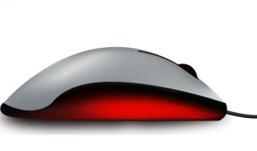
What does a mouse do?
Your Progress
Options
A mouse is used to INPUT data (commands) into the computer.
Page 1 2 3 4 5 ...
Help
Notes:
When an activity is selected, the icon of that part will appear in the lower left hand corner of each page. The learner should click this icon if he/she wants to return to the list of computer parts. The home icon (how computers work icon) in the lower left hand corner takes the learner back to the home page. The progress bottom of the top indicates how many pages and the learner’s progress through all of the pages for the current computer part. Text will be presented with speech. Text can be clicked again to hear the sentence again.

Slide 7
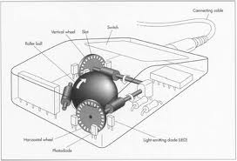
How does a mouse work?
Click the parts of the mouse to learn about their function
Your Progress
Options
Ball: It rolls when the mouse is moved on a surface.
Page 1 2 3 4 5 ...
Help
Notes:
When an activity is selected, the icon of that part will appear in the lower left hand corner of each page. The learner should click this icon if he/she wants to return to the list of computer parts. The home icon (how computers work icon) in the lower left hand corner takes the learner back to the home page. The progress bottom of the top indicates how many pages and the learner’s progress through all of the pages for the current computer part. Text will be presented with speech. Text can be clicked again to hear the sentence again. The magnifying glass can be clicked to enlarge the picture.

Slide 8
Computer Parts
Learn about the mouse
Activity 1: Images of the mouse
Activity 2: Find the parts
Activity 3: Function Sort
Your Progress
Options
Help

Slide 9
Teacher Portal
Logout
Student Roster
Samantha Moses
Ethan Smith
Abraham Jackson
Timothy Brown
Allison Cooper
Elliot Boatner
Walter Kyles
Name Select Student
Score Breakdown
Generate Class/Student Report
Assign/Delete Modules
Disable/Enable Software Features
Modify Student Accessibility
Options
Add/Delete Student

